Slide 1
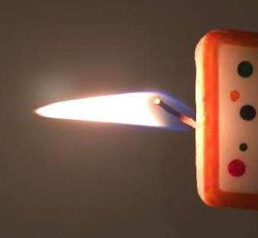
Heat
Heat Transfer
LabRat Scientific
© 2018

Slide 2
What is “Heat”
Prior to the 19th Century, it was thought that an object’s temperature was due to the amount of “caloric” it contained. This implied there was some sort of physical material than governed an object’s temperature. Two objects with different temperatures would transfer caloric when they were placed in contact. The flow of caloric would cease when the levels were the same in each object – which meant they were at the same temperature
We know today that an object’s temperature is not due to a physical substance, however we still think of “heat” as a “something” that is transferred from one object to another. A common definition of heat is “that which is transferred between a system and its surroundings as a result of temperature differences only”. Not a great definition, but it is an accepted one…

Slide 3

What is “Heat”
The “that” in the definition is actually “energy”.
The definition mentions “that which is transferred”, which means the energy moves from one object to another. There are three ways heat can be transferred…

Slide 4
Heat Transfer (a.k.a. Heat Flow)
Heat flows from areas of high temperatures towards areas of low temperatures.
The rate of heat flow is a function of the temperature difference between the hot region and the cooler region. The larger the temperature difference, the higher the flow of heat.
Thermal equilibrium is the condition where the heat entering a point is equal to the heat leaving a point. Under these condition the temperature will no longer change. This does not necessarily mean the object has the same temperature along its length.

Slide 5
Heat Transfer Equations
These equations will be addressed during this LabRat Lesson
dT
H = - k A -----
dx
The Heat Conduction Equation (Conduction)
∆Q
C = --------
∆T
Heat Capacity. “Q” is the unit of heat which is defined as the heat necessary raise the temperature of 1 kg of water from 14.5 C to 15.5 C by one kilocalorie. (Conduction)
∆Q
c = --------
m ∆T
Specific Heat (Conduction)
L
R = -----
k
Thermal Resistance (Conduction)

Slide 6
Heat Transfer Equations
These equations will be addressed during this LabRat Lesson
Q_{emitted} = ϵ σ T⁴ Stefan-Boltzmann law (Radiation)
P = ϵ σ A T⁴ Total Radiated Power (Radiation)

Slide 7
Ways Heat Can be Transferred
Convection – a fluid (air, water, etc) that is heated will expand and tend to rise setting up a circulation that carries heat from one object to another.
Conduction – heat moving along a physical object (e.g. metal rod) from a region of high temperature to a region of lower temperature.
Radiation – electromagnetic radiation generated by a hot object propagates away from the object as waves. The radiation can be absorbed by other objects

Slide 8
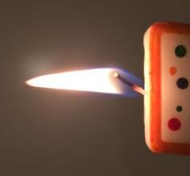
Convection
A fluid (water, air, etc.) is heated above the heat source (i.e. flame). The hot fluid becomes less dense and rises. Cooler fluid fills in behind the rising fluid and itself becomes heated.
When the heated fluid encounters a cooler object, the fluid looses heat to that object and becomes more dense (and less buoyant) and then sinks.
This process ultimately causes the temperature of the cooler object to rise.

Slide 9
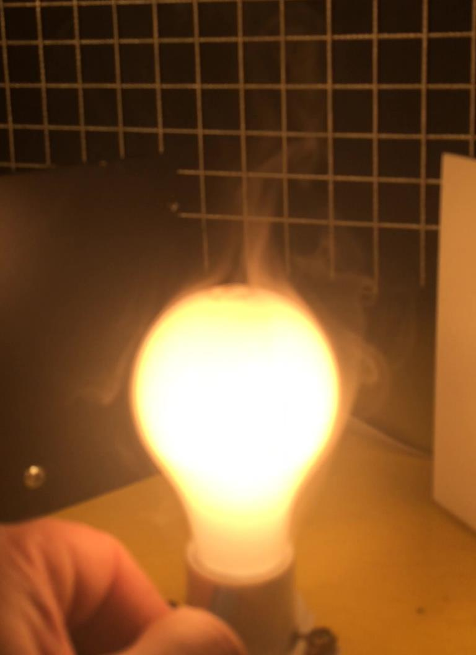
Detecting Convection Currents
Smoke injected near the base of a hot lightbulb can be used to detect how the air (fluid) is moving.
The wisps of smoke above the bulb in this image are moving upwards, proving that the air around the lightbulb is getting heated, becoming less dense, and then rising above the bulb.

Slide 10
The heated air surrounding the lightbulb rises…
Then cooler air fills the void left by the rising air. This new cooler air is then heated by the lightbulb…

Slide 11
If the lightbulb were placed in a closed box, a circulating air current would be created.
The hot air heated by the bulb rises to the top of the box, cools slightly then descends around the outside of the box. After the air descends, it is pulled into the base of the bulb where it is reheated and once again rises.
This is a convection current…

Slide 12
Conduction
Heat Flow
The metal rod heats up in the flame. The atoms become more excited with the addition of heat energy. This energy is then passed on to cooler adjacent atoms. Eventually the heat moves along the rod towards the cooler end.

Slide 13
The concept of “conduction” can be demonstrated using a simple experimental set-up. Care must be exercised to avoid fire or burn injuries if the following demonstration is attempted…

Slide 14
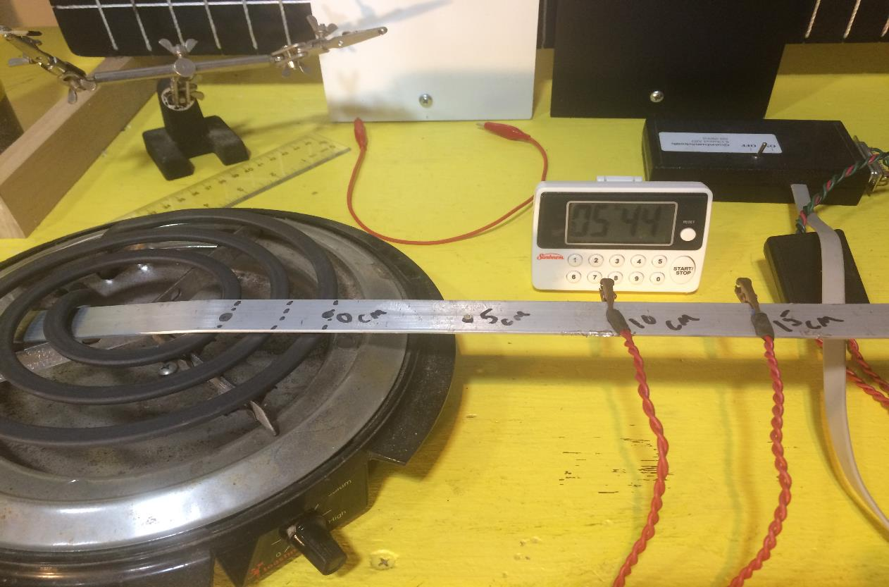
Uninsulated Conduction Experiment – Test Set Up
The Test Bar is in contact with the hot plate heating coil.
Heat is conducted along the aluminum Test Bar.
The Inner and Outer thermistors measure the temperature of the Test Bar as a function of time.
Hot Plate
Test Bar (Aluminum)
Inner Thermistor
Outer Thermistor

Slide 15
Test Set Up:
A computer-based temperature measuring system was used to collect the test data as a function of time
The Inner Test Point is 5 cm from the outer hot plate heating coil
The Test Points were 5 cm apart
The hot plate temperature was set at low (a setting of “2” on the hot plate used). The system will heat up quickly so a high heat setting is not necessary.
Temperature data was collected every 30 seconds

Slide 16
Conduction Experiment (uninsulated) – Observations
The inner test point (closest to the hot plate) heated up faster (i.e. had a steeper temperature curve slope).
The Test Points reached a maximum temperature nearly 2 minutes before the hot plate was turned off.
Hot Plate ON
The Inner Test Point appears to have cooled slightly (at ~ 7.5 min) while the Outer Test Point appears to have heated slightly.
Hot Plate OFF
It took about 30 to 60 seconds for the test points to begin cooling after the hot plate was turned off.

Slide 17
In many cases, two or more of the heat transfer mechanisms can be in play at the same time. In fact, heat loss (i.e. “cooling”) can be going on at the same time as heating. In the case of this convection experiment, the exposed aluminum bar is radiating heat to the surrounding air, and convection currents exist which draws heat away from the bar. This means less heat is being transmitted along the bar. As such, the experiment was not a purely convective system.
A second improved experiment can be conducted to minimize these cooling effects…

Slide 18
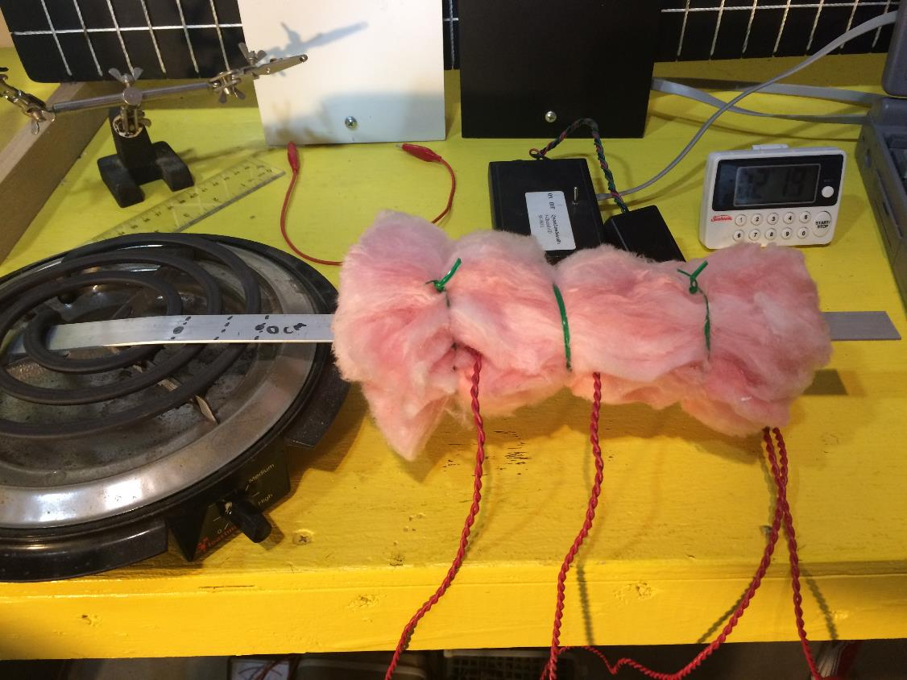
Insulated Conduction Experiment – Test Set Up
The same thermistor placement and hot plate temperature setting were use for the insulated experiment.
Fiberglas insulation was used to insulate the test bar. The insulation reduced the radiation and convection effects.

Slide 19
Conduction Experiment (insulated) – Observations
The inner test point (closest to the hot plate) heated up faster (i.e. had a steeper temperature curve slope) as in the previous experiment.
Hot Plate ON
Both test points reached a maximum temperature then held that temperature over time until the hot plate was turned off.
Hot Plate OFF
There seemed to be very little cooling time lag once the hot plate was turned off.

Slide 20
Comparison – Insulated and Uninsulated Test Point Temperatures
Hot Plate OFF
Even though the hot plate temperature setting was the same for both tests, the insulated bar reached higher temperatures.
The slopes of the temperature lines are nearly identical for the first 2 minutes of the experiment.

Slide 21
While the temperature curves give a good indication of what is going on, we can look at another parameter that can provide some more insight. This parameter is the “Heat Conduction Rate”.

Slide 22
Heat Conduction Rate
The Heat Conduction Equation is as follows:
H = Heat Transfer Rate (calories per second)
dT
H = - k A -----
dx
k = Thermal Conductivity (calorie / (meter * ⁰C * Sec) )
A = Cross-sectional Area of the heat path that heat
is traveling along (m²)
dT/dx = Temperature Gradient along heat path
Note: Since heat moves from “hot to cold” the dT in the equation would be negative. The negative sign is introduced in the equation to make “H” positive as we move long the bar. Since the following calculations use the absolute value of the dT, the negative sign will be dropped.

Slide 23
Heat Conduction Rate
This equation states that the heat flowing along a uniform conduction path (i.e. aluminum bar) is a function of:
The temperature difference between the hot end of the path and the cold end of the path (dT/dx). Larger gradient = more heat flowing along the rod.
The cross-sectional area of the conduction path (A). A path with a larger cross-sectional area will conduct more heat.
The Thermal Conductivity (k) of the material making up the conduction path. A material with a higher thermal conductivity will conduct heat faster.

Slide 24
Calculating the Heat Transfer Rate
We can use the Heat Transfer Rate equation to calculate the heat transfer rates associated with the experiment. But first we need to determine the thermal conductivity of the aluminum bar and calculate some physical parameters:
Material | k ( cal/(m*C*s ) )
Steel | 11
Aluminum | 48
Wood | 0.026
Fiberglass Insulation | 0.011
A _{Test Bar} = 2.0 cm x 0.2 cm
= 0.02 m x 0.002 m = 0.00004 m²
dx = 6.0 cm = 0.05 meter
Distance between test points
Let’s look at the experimental data for Test Point_{Inner} and Test Point_{Outer} at two different time (T=120 sec and T=180 sec). The next step is to calculate the temperature differences between the two test points at the two different times...

Slide 25
Experimental Data @ Time = 120 sec
From the experimental data for the Inner and Outer Test Points:
Time₁₂₀: Temp_{inner} = 36 ⁰C
Time₁₂₀: Temp_{outer} = 22 ⁰C
∆T = 36 ⁰C - 22 ⁰C = 14 ⁰C
36 ⁰C
22 ⁰C
Point_{inner}
Point_{outer}
Hot Plate

Slide 26
Experimental Data @ Time = 180 sec
From the experimental data for the Inner and Outer Test Points:
Time₁₈₀: Temp_{inner} = 49 ⁰C
Time₁₈₀: Temp_{outer} = 31 ⁰C
∆T = 49 ⁰C - 31 ⁰C = 18 ⁰C
60 sec
49 ⁰C
31 ⁰C
Point_{inner}
Point_{outer}
Hot Plate

Slide 27
Notice that the ∆T’s are different for the two experiment times. This means that the Heat Transfer Rate between the two points is changing over time.
The Heat Transfer Rates are calculated as follows…

Slide 28
Heat Transfer Rate at Time₁₂₀
36 ⁰C
22 ⁰C
H
Point_{inner}
Point_{outer}
Hot Plate
dT 14 ⁰C
H = k A ----- = 48 (cal / (m*⁰C*s)) * 0.00004 m² * -----------
dx 0.05 m
cal 15 ⁰C
= 48 ------------ * 0.00004 m² * -----------
m*⁰C*s 0.05 m
= 0.53 cal / sec

Slide 29
Heat Transfer Rate at Time₁₈₀
49 ⁰C
31 ⁰C
H
Point_{inner}
Point_{outer}
Hot Plate
dT 18 ⁰C
H = k A ----- = 48 (cal / (m*⁰C*s)) * 0.00004 m² * -----------
dx 0.05 m
cal 18 ⁰C
= 48 ------------ * 0.00004 m² * -----------
m*⁰C*s 0.05 m
= 0.69 cal / sec

Slide 30
A simple spreadsheet can be developed to calculate the heat flow rate between the Inner and Outer test points as a function of time over the duration of the experiment. The data can then be plotted to look for trends…

Slide 31
Calculated Heat Conduction Rate between Test Points
The ragged nature of the data lines are due to the H-equation’s sensitivity to the Delta-Temperature values. Vertical variations are due to data noise during the data collection and rounding of numbers during the calculations.

Slide 32
Conduction Experiment – Conclusions
Heat was conducted along the aluminum test bar, moving from the hot end towards the cool end (as predicted by theory).
Thermal radiation and convection during the uninsulated experiment had a significant effect on the temperature of the test bar. Good insulation is needed to produce a valid thermal conductivity experiment.
The higher slope of the temperature curve during the early minutes of the experiments indicate a higher heat flow rate. This is confirmed by the Heat Conduction Rate calculations.
Thermal equilibrium along the bar can be achieved as shown in the insulated experiment.

Slide 33
Heat Capacity and Specific Heat
Heat Capacity (C) is the heat added to a material per unit temperature rise. Specific Heat (c) is the heat capacity per unit mass of a body.
∆Q
Heat Capacity = C = --------
∆T
“Q” is the unit of heat which is defined as the heat necessary raise the temperature of 1 kg of water from 14.5 C to 15.5 C by one kilocalorie.
Material | Specific Heat ( cal / (g * ⁰C) )
Aluminum | 0.215
Carbon | 0.121
Copper | 0.092
Lead | 0.031
The concept of Specific Heat tells us that the more massive the object, the more heat that is required to raise the object’s temperature by one degree.

Slide 34
Thermal Resistance (R)
The Thermal Resistance Equation can be used to calculate the R-value for any material.
L
R = -----
k
L = Thickness of the material
k = Thermal Conductivity of the material
The units for Thermal Resistance (R-value) are:
ft² * ⁰F * hr/BTU (or)
m² * ⁰K / watt
Material | k ( cal / (m*C*s ) )
Steel | 11
Aluminum | 48
Wood | 0.026
Fiberglass Insulation | 0.011

Slide 35
Sample Problem: What is the R-value for a 0.25 m thick batten of fiberglass insulation?
L 0.25 m
R = ----- = ----------------------------------
k 0.011 cal / (m * ⁰C * sec)
m * ⁰C * sec
= 0.25 m * -------------------
0.011 cal
These are not the units that are accepted as the SI Units for R-value. As such we need to do some conversion…
m² * ⁰C * sec
= 22.7 ----------------------
cal

Slide 36
Unit Conversion
1,000 cal = 4,187 Joule
1 cal = 4.187 Joule
1 watt = 1 Joule / sec
1 Joule = 1 watt * sec
⁰C = ⁰K - 273⁰
m² * ⁰C * sec
= 22.7 ----------------------
cal
1 cal
---------------
4.187 Joule
1 Joule
------------------
1 watt * sec
m² * ⁰C
= 5.4 --------------
watt
Since the increment for a Degree of Celsius is the same as the increment for a Degree of Kelvin, these units are the same as (m² * ⁰K) / watt.
Multiply the R-value in SI Units by 5.68 to get the R-value that we are used to seeing in our local home improvement store… R = 30.7

Slide 37
Radiation
All hot objects give off electromagnetic radiation. The energy emitted changes by the fourth power of the object’s temperature. This radiation propagates through space and can transfer energy (heat) to another cooler object.

Slide 38
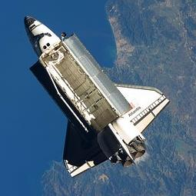
For a spacecraft in space, the only way to release heat is by radiation.
The Space Shuttle had to have huge radiators attached to the cargo bay doors so the heat generated by the onboard electrical systems could be shed into space.

Slide 39
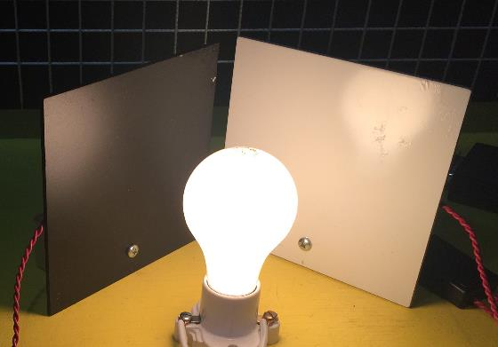
Radiation “Reflection” and “Absorption”
We see colors, because colored surfaces reflect certain colors (wavelengths of electromagnetic radiation) and absorb others.
A red plate looks red to our eye because the red paint reflects the red light and absorbs the other colors of the light spectrum (violet, yellow, etc.)
A white plate looks white because it reflects nearly all of the color spectrum. A black plate looks black because it doesn’t reflect much of the color spectrum. If the light (a.k.a. radiation) is not being “reflected”, it is being “absorbed”. When an object absorbs energy it will get hotter.
We can conduct an experiment to show this…

Slide 40
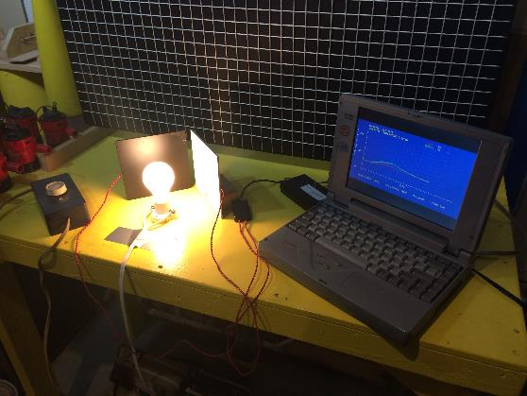
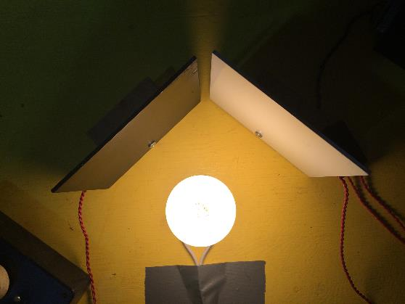
Thermal Radiation Experiment
An experiment can be created to demonstrate how heat is radiated, reflected, and absorbed.
This experiment uses an incandescent light bulb as the heat source. Aluminum plates, one painted black and one white, serve as test objects.
Thermistors (electronic heat sensors) are attached to the backs of the plates. Temperature data is displayed and stored on a computer.
Goal: To demonstrate heating due to thermal radiation and examine heat absorption as a function of plate color.

Slide 41
Thermal Radiation Experiment
The test plates are the same material (aluminum), thickness, and surface area.
There is no heat conduction path between the lightbulb and the test plates.
The experiment is being conducted in a large room so any warm air that is generated by the hot lightbulb goes straight up and does not circulate around the test plates. This means that there is no convection heating on the plates (if there is any, it is negligible).

Slide 42
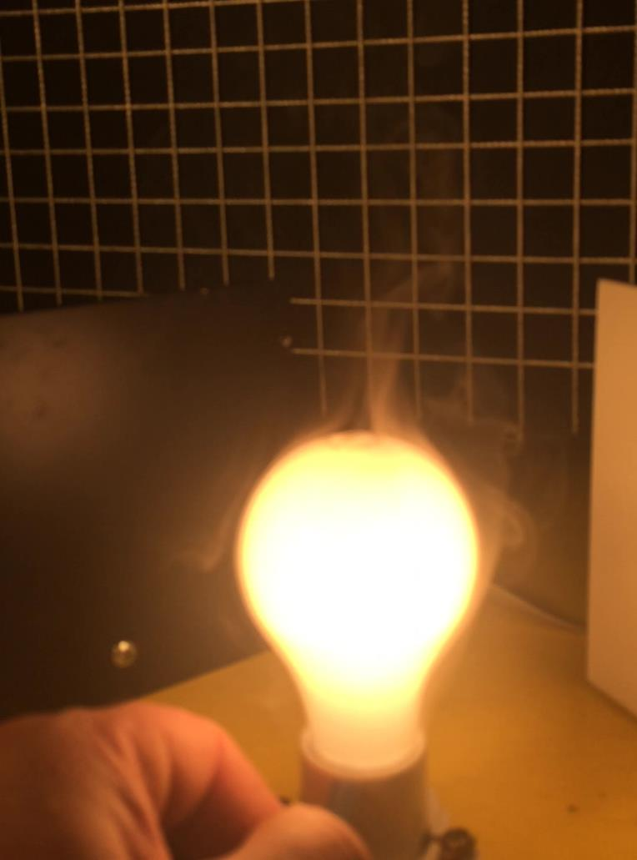
Here, fog from a fog machine was used to visualize the convection current generated by the hot lightbulb.
While it’s a little difficult to see, the fog is being pulled up around the bulb and then ascending above the bulb. There is no fog traversing laterally in any significant manner.

Slide 43
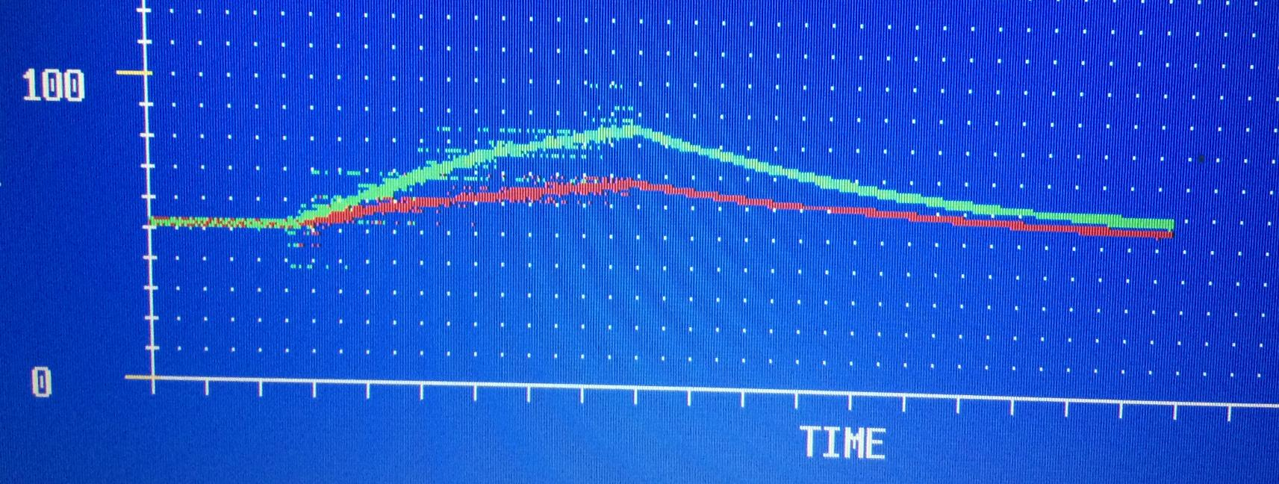
Experimental Data (Trail #1)
Max = 85⁰ F
Black Plate
52⁰ F
50
Max = 69⁰ F
White Plate
Original Trial #1 data potted on the computer screen in real time. Notice the “noise” in the data which comes from extraneous electrical signals generated by the incandescent lightbulb. Notice how the signal improves once the lightbulb is turned off and cooling begins.

Slide 44
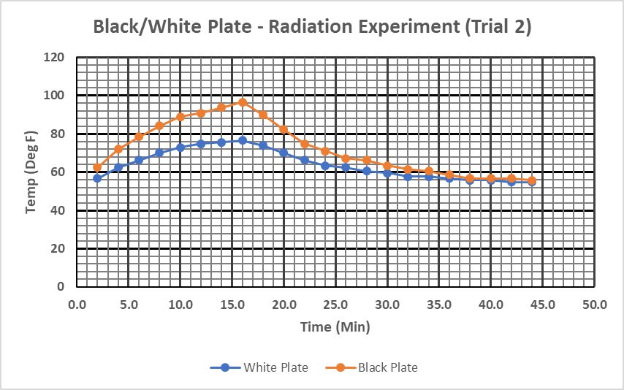
This was Trial #2. The maximum temperature is higher than Trial #1 because the lightbulb was left on longer…
Heating
Cooling
Lightbulb turned off
Lightbulb on at maximum intensity

Slide 45
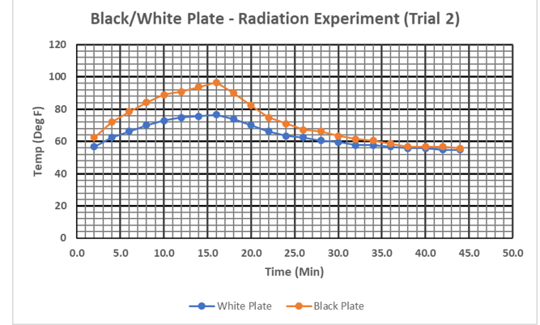
Radiation Experiment - Observations
The temperature of the plates increased when the light bulb was turned on.
The Black Plate’s temperature rose faster and ultimately got hotter.
Both plates ended up at the same temperature after cooling, but the Black Plate started at a higher temperature.
Once the two plates reached a similar temperature after cooling, the cooling rates became similar.
The heating and cooling lines are not linear.

Slide 46
Radiation Experiment - Conclusions
Since there is no convection or conduction, the plates must have been heated by electromagnetic radiation being generated by the lightbulb.
Since the Black Plate got hotter, it must have absorbed more of the electromagnetic radiation and thus more heat.
Since the Black Plate’s cooling line has a larger negative slope (its steeper) , its cooling rate was higher. This could be due to two factors:
  The black coloring radiated heat faster
  The higher temperature between the Black Plate and the ambient air caused the plate to transfer heat to the air faster – thus cooling at a higher rate
An experiment can be conducted to further investigate Conclusion #3…

Slide 47
Radiation Experiment - Conclusions
As the plates got hotter, the temperature differential between the plates and air increased, this larger Delta-T difference cause higher radiation of heat from the plates (i.e. off the back side), thus the net heat flow into the plates was not as great over time. This causes the temperature curves to be non-linear.
The same can be said for the cooling curves. As the temperatures of the plates got closer to the ambient air temperature, the heat flow decreased.

Slide 48
Cooling Experiment (Testing Conclusion #3)
When the plates are cooling, there are two heat transfer mechanisms at work…
The air adjacent to the warm plates is warmed and then rises, with cooler surrounding air filling the void created by the rising warm air. As such, convection cooling exists.
The warm plates also emit electromagnetic radiation and thus give off heat to the surroundings. As such, radiation cooling exists.
This happens to both the black and white plates. The question is, does one color radiate heat faster?

Slide 49
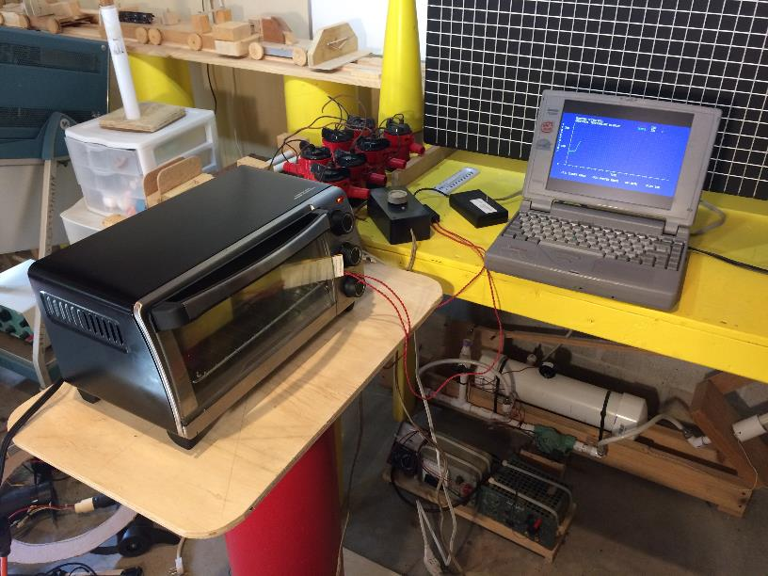
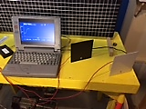
Experimental Set-up
Plates in a toaster oven being heated
Plates outside the oven while data is being collected during cooling

Slide 50
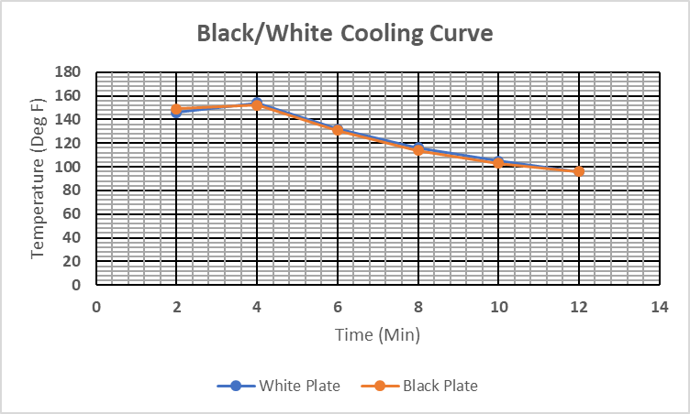

Slide 51
Cooling Experiment (Testing Conclusion #3)
The plates were heated in the oven to a temperature of approximately 153 Deg F. They were then removed and placed apart so they would not radiate to each other.
Observations:
The cooling lines were one top of one another
The cooling lines were not linear
Conclusions:
The color of the plates did not appear to affect the cooling rate
The non-linearity of the cooling lines is due to the fact that the heat flow to the surroundings is a function of the temperature differential between the plates and the ambient air. As the plates cooled, the temperature differential was smaller and thus the heat flow was lower.

Slide 52
Radiation – Governing Equations
Radiative Flux (Q) = P/A = Radiated Power / Unit Area = Watts / meter²
Emissivity (ϵ) = Unitless ratio of a surfaces ability to emit radiant energy compared to the ability of a perfect black body of the same area and temperature. ϵ = 1 for a perfect reflector. ϵ = 0 for a perfect absorber.
Material | Emissivity
Aluminum | 0.11
Brass (polished) | 0.03
Gold (polished) | 0.02
Black Gloss Paint | 0.90
Stefan’s Constant (σ) = 5.67x10⁻⁸ Watt / (meter² * Kelvin⁴)

Slide 53
Radiation – Governing Equations
Q_{emitted} = ϵ σ T⁴ Stefan-Boltzmann law
P / A = ϵ σ T⁴ Radiated Power per unit Area
P = ϵ σ A T⁴ Total Radiated Power
P = ϵ σ A ( T⁴ - T_{c}⁴ )
The Temperature (T) is in degrees Kelvin. “T” is the temperature of the hot object and “T_{c}” is the temperature of the surroundings.

Slide 54

The bare aluminum back side of the plate is about 9x less emissive than the black side. This means heat will not be radiated away from the plate as well.
Black paint has a fairly high emissivity and thus is a good absorber of thermal radiation. This means it will get warm…
Cool surrounding temperature
High surrounding temperature
Q
Q
Since the heat flux going into the plate is higher than the heat flux going out, the plate will get hotter.

Slide 55
Sample Problem: How much radiated power is emitted by a 0.02 m² (the size of the plates used in the radiation experiment) bare aluminum plate that is at a temperature of 100 ⁰C ?
Q_{emitted} = ϵ σ T⁴ Stefan-Boltzmann law
Q_{emitted} = Power_{Radiated} / Area = P / A
Power_{Radiated} = Q_{emitted} * Area = ϵ * σ * T⁴ * A
Values relevant to this sample problem.
σ = 5.67x10⁻⁸ Watt / (meter² * Kelvin⁴)
Emissivity_{Aluminum} = ϵ = 0.11
T = 100 ⁰C + 273 = 373 ⁰K

Slide 56
Crunching the Numbers…
Power_{Radiated} = 0.11 * 5.67x10⁻⁸ w / (m² * ⁰K⁴) * (373 ⁰K)⁴ * 0.02 m²
Power_{Radiated} = 0.11 * 5.67x10⁻⁸ w / (m² * ⁰K⁴) * 1.936x10¹⁰ ⁰K⁴ * 0.02 m²
Power_{Radiated} = 2.4 watts
This doesn’t appear to be a significant amount of radiated power, after all decorative holiday electric window candles are usually rated at 5 watts and they don’t put out much heat. A simple experiment can be conducted to get a sense of the heat associated with that small radiated power.

Slide 57
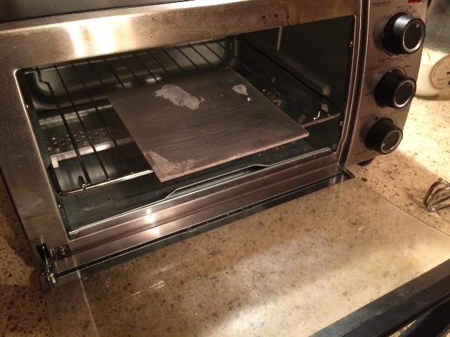
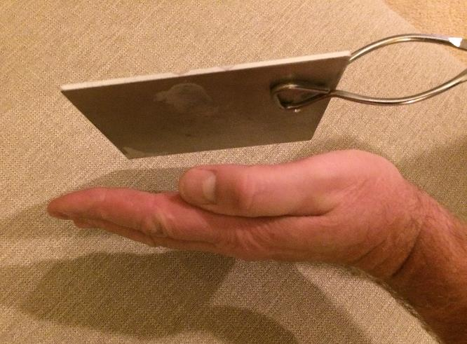
A 0.02 m² aluminum plate is heated to 100 ⁰C (212 ⁰F) in a toaster oven. The plate is carefully removed using tongs. This must be done carefully to prevent burns to the hands…
The heat being given off was sensed by placing my hand near the plate. In this case, even though the plate was hot enough to cause pain if touched, the radiated heat was rather minor. This qualitative test seems to support the calculated radiated power…

Slide 58
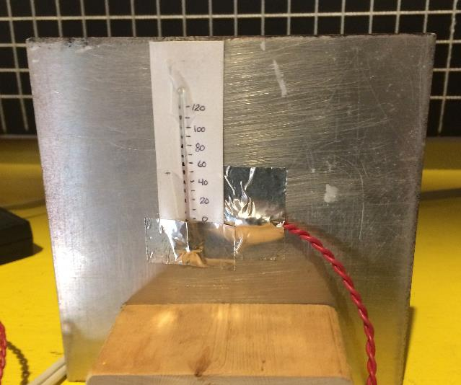
You don’t have access to a computer-based temperature measuring system?
Simple mercury thermometers can be used to conduct these experiments. There are a few things to keep in mind:
The thermometer bulb must be in intimate contact with the test plates
Data should be taken at 5 minute intervals or less to get good temperature curves
Other temperature measuring devices can be used as well.

Slide 59
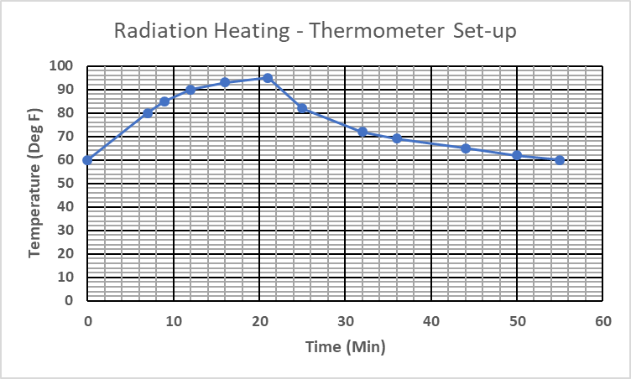

This data set has the same shape, magnitude, and characteristics as the data set collected using the computer-based thermistors…

Slide 60

One last practical example of heat transfer at work in the real world…

Slide 61
Why are household electric bills generally higher in the winter?
As stated in this lesson, heat flow is a function of ∆Temperature.
Looking at the two cases at the left, it is more likely that the difference in temperature between the inside and outside of the house is greater in the winter. This means more heat will flow out of the house in the winter than flows into the house in the summer.
If we consider a compressor-only heating and cooling comparison, more electricity is needed to compensate for a higher heat loss in the winter.
Summer
70 ⁰F
95 ⁰F
∆Temp = 25 ⁰F
Winter
70 ⁰F
25 ⁰F
∆Temp = 45 ⁰F

Slide 62
Questions ?

